Slide 1

Prim’s Minimum Spanning Tree
Generated using Claude
DESIGN AND ANALYSIS OF ALGORITHMS
Name : ANAGHA YENORKAR
PRN : 25070521342
Class : A2
Notes:
Welcome. This presentation covers Prim’s algorithm, a greedy method from the Design and Analysis of It was generated using Claude.
Name : ANAGHA YENORKAR
PRN : 25070521342
Class : A2

Slide 2
What is a minimum spanning tree?
Spanning
Tree
Minimum
Touches every vertex, so the whole graph stays connected.
Uses exactly V − 1 edges and contains no cycle.
Total edge weight is as small as any spanning tree can achieve.
Input: a connected, weighted, undirected graph G = (V, E). Real-world use: laying cables, pipes or roads to link every site at the lowest total cost.
2
Notes:
An MST of a connected weighted graph spans all vertices, has no cycle and therefore V minus 1 edges, and has the smallest possible total weight.

Slide 3

The greedy idea
Greedy choice
Cut property
At every step, take the cheapest edge that grows the tree. Never look back and never undo a choice.
For any split of the vertices, the lightest edge crossing the split belongs to some minimum spanning tree.
Tree S
cheapest crossing edge
Remaining vertices V − S
3
Notes:
Prim’s algorithm keeps one growing tree S. The cut property guarantees that the lightest edge leaving S is safe to add, so a purely greedy strategy still produces an optimal tree.

Slide 4
The algorithm in four steps
01
02
03
04
Start
Look
Add
Repeat
Pick any vertex and place it in the tree.
Find the edges that join the tree to vertices outside it.
Take the cheapest of those edges and bring its new vertex into the tree.
Go back to step 2 until all V vertices are in the tree.
Ties may be broken arbitrarily. The total weight of the tree stays the same.
4
Notes:
Walk through the four steps. After V minus 1 additions the tree spans the whole graph.

Slide 5
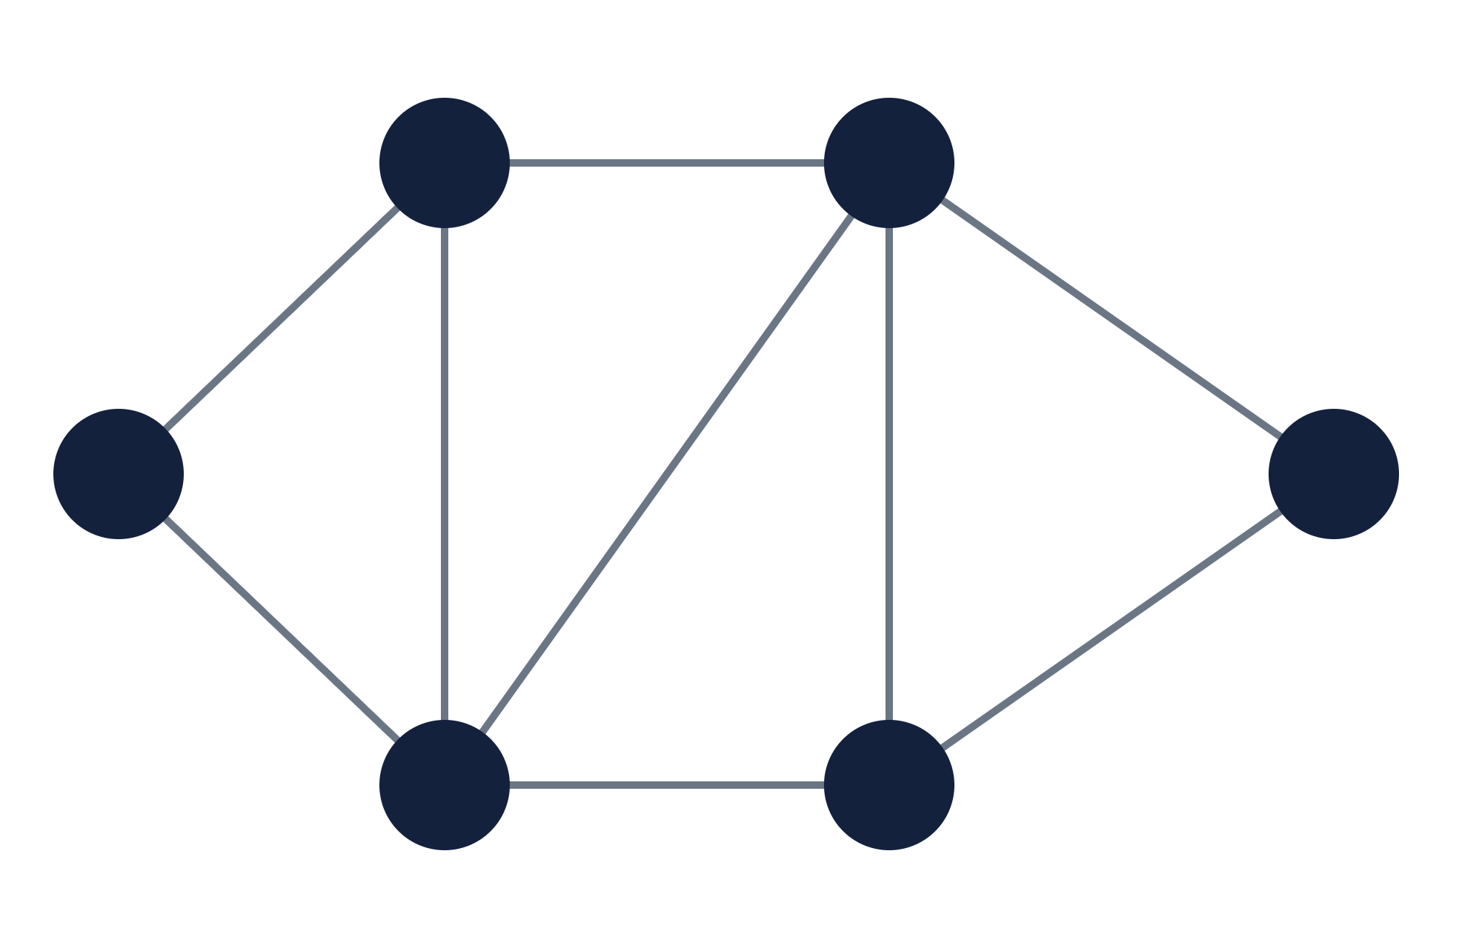
Example graph
The problem
B
5
D
6 vertices and 9 weighted edges.
4
6
Start vertex: A.
Goal: connect every vertex with the smallest total edge weight.
A
1
8
2
F
2
3
C
10
E
5
Notes:
Our running example. The numbers on the edges are weights. We start Prim’s algorithm from vertex A.

Slide 6
Step-by-step trace from A
Step | Tree so far | Candidate edges | Picked | Total
1 | {A} | A–B 4, A–C 2 | A–C (2) | 2
2 | {A, C} | A–B 4, C–B 1, C–D 8, C–E 10 | C–B (1) | 3
3 | {A, B, C} | B–D 5, C–D 8, C–E 10 | B–D (5) | 8
4 | {A, B, C, D} | D–E 2, D–F 6, C–E 10 | D–E (2) | 10
5 | {A, B, C, D, E} | D–F 6, E–F 3 | E–F (3) | 13
A–B (4) is never picked: after step 2 both its ends are already in the tree, so adding it would form a cycle.
6
Notes:
At each step list the edges leaving the tree, pick the cheapest, and add its new vertex. Five picks connect all six vertices with total weight 13.

Slide 7
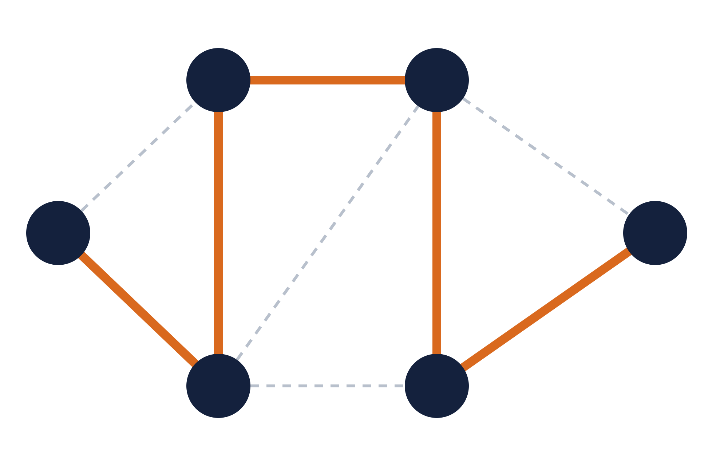
Resulting minimum spanning tree
Total weight
B
5
D
13
4
6
Thick edges in the tree: A–C, C–B, B–D, D–E, E–F
A
1
8
2
F
Dashed edges discarded: A–B, C–D, C–E, D–F
2
3
5 edges = V − 1, and no cycles.
C
10
E
7
Notes:
The final tree uses edges A–C, C–B, B–D, D–E and E–F for a total weight of 2 plus 1 plus 5 plus 2 plus 3, which is 13. Kruskal’s algorithm gives the same total.

Slide 8
Time complexity
Implementation | Time | Best for
Adjacency matrix, linear scan | O(V²) | Dense graphs
Adjacency list, binary heap | O(E log V) | Sparse graphs
Adjacency list, Fibonacci heap | O(E + V log V) | Very large graphs
Space: O(V + E) with an adjacency list, O(V²) with a matrix.
8
Notes:
The running time depends on how the vertices outside the tree are stored. A simple array gives V squared, a binary heap gives E log V, and a Fibonacci heap improves the bound further in theory.

Slide 9
Pseudocode
key[v]
PRIM(G, w, s):
Cheapest edge weight linking v to the tree.
for each v in V: key[v] ← ∞, parent[v] ← NIL
key[s] ← 0; Q ← V
while Q is not empty:
parent[v]
u ← EXTRACT-MIN(Q)
The tree vertex that edge comes from.
for each v adjacent to u:
if v in Q and w(u, v) < key[v]:
Q
parent[v] ← u; key[v] ← w(u, v)
Min-priority queue of vertices outside the tree.
9
Notes:
Each vertex keeps the weight of its cheapest connection to the tree. EXTRACT-MIN pulls out the vertex with the smallest key, and its neighbours then update their keys. The parent array records the tree edges.

Slide 10
Key takeaways
Prim’s algorithm grows one tree, always adding the cheapest edge that leaves it.
The cut property guarantees the result is a minimum spanning tree.
Time: O(V²) with a matrix, O(E log V) with a binary heap.
Used in network design, road and cable layout, and clustering.
Generated using Claude
11
Notes:
To recap: one growing tree, the cheapest crossing edge each time, and an optimal result thanks to the cut property. This presentation was generated using Claude.

